Slide 1
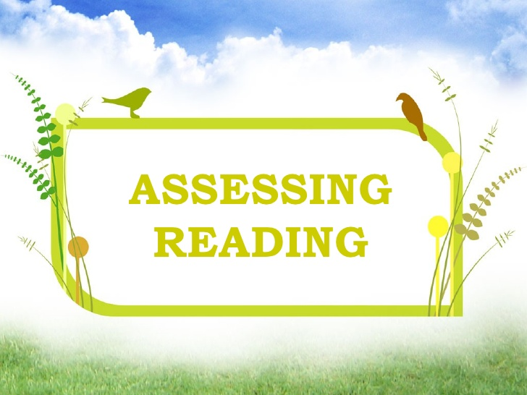
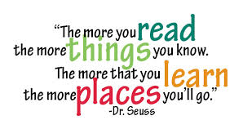
TestingReading
Cinthya Canton
Angel Jiménez
Evaluation Techniques
October 2015

Slide 2
What is Reading?
Reading is an activity with a purpose. A person may read in order to gain information or verify existing knowledge, or in order to critique a writer's ideas or writing style.
A person may also read for enjoyment, or to enhance knowledge of the language being read. The purpose(s) for reading guide the reader's selection of texts.
The purpose for reading also determines the appropriate approach to reading comprehension.
Example: A person reading poetry for enjoyment needs to recognize the words the poet uses and the ways they are put together, but does not need to identify main idea and supporting details.
Reading is important because much info we need is communicated in texts.
We need reading to function in this modern world.
It help us to learn a new language. It opens up worlds.
It brings prior knowledge, cognitive development and text processing.

Slide 3
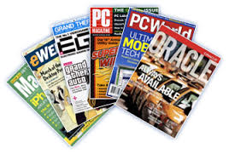
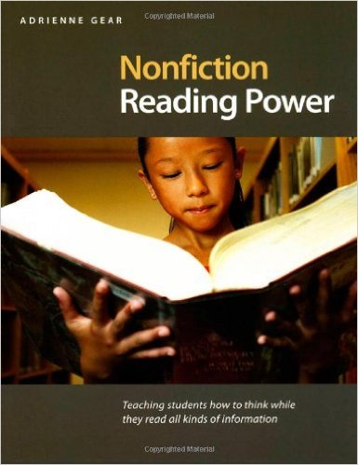
Kinds of Reading
Academic Reading general interest articles, professional journal articles reference material textbooks. theses essays, papers test directions editorials and opinion writing. It is also called Intensive reading.
Personal Reading, newspapers, magazines letters, emails, greeting cards, invitations messages, notes, lists schedules, menus, maps, calendars advertisements novels, short stories, jokes, drama, poetry financial documents. It is also called Extensive reading.

Slide 4
Assesment
The assessment of reading ability does not end with the measurement of comprehension. Strategic pathways to full understanding are often important factors to include in assessing learners, especially in the case of most classroom assessments that are formative in nature. All assessment of reading must be carried out by inference.
Importance
Importance of Genres of Reading It enables the readers to apply certain schemata that will assist them in extracting appropriate meaning. Efficient readers have to know what their purpose is in reading a text, the strategies for accomplishing that purpose and how to retain the information.
In everyday reading situations, readers have a purpose for reading before they start. That is, they know what comprehension questions they are going to need to answer before they begin reading. To make reading assessment in the language classroom more like reading outside of the classroom, therefore, allow students to review the comprehension questions before they begin to read the test passage.
Finally, when the purpose for reading is enjoyment, comprehension questions are beside the point. As a more authentic form of assessment, have students talk or write about why they found the text enjoyable and interesting (or not).

Slide 5
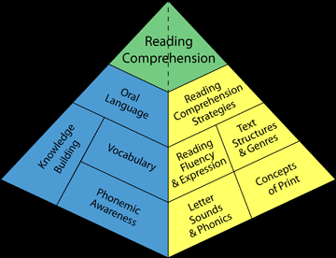

Slide 6
When reading to learn, students need to follow four basic steps:
Figure out the purpose for reading. Activate background knowledge of the topic in order to predict or anticipate content and identify appropriate reading strategies.
Check comprehension while reading and when the reading task is completed. Monitoring comprehension helps students detect inconsistencies and comprehension failures, helping them learn to use alternate strategies.
Attend to the parts of the text that are relevant to the identified purpose and ignore the rest. This selectivity enables students to focus on specific items in the input and reduces the amount of information they have to hold in short-term memory.
Select strategies that are appropriate to the reading task and use them flexibly and interactively. Students' comprehension improves and their confidence increases when they use top-down and bottom-up skills simultaneously to construct meaning.

Slide 7
Developing Reading Activities
Construct the reading activity around a purpose that has significance for the students
Check the level of difficulty of the text
Use pre-reading activities to prepare students for reading
Define the activity's instructional goal and the appropriate type of response
Match while-reading activities to the purpose for reading An After-reading Activities.

Slide 8
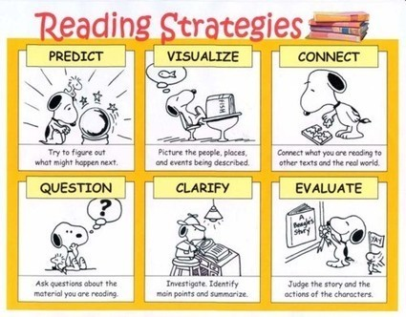
https://www.youtube.com/watch?v=ErCcnRR-39I

Slide 9
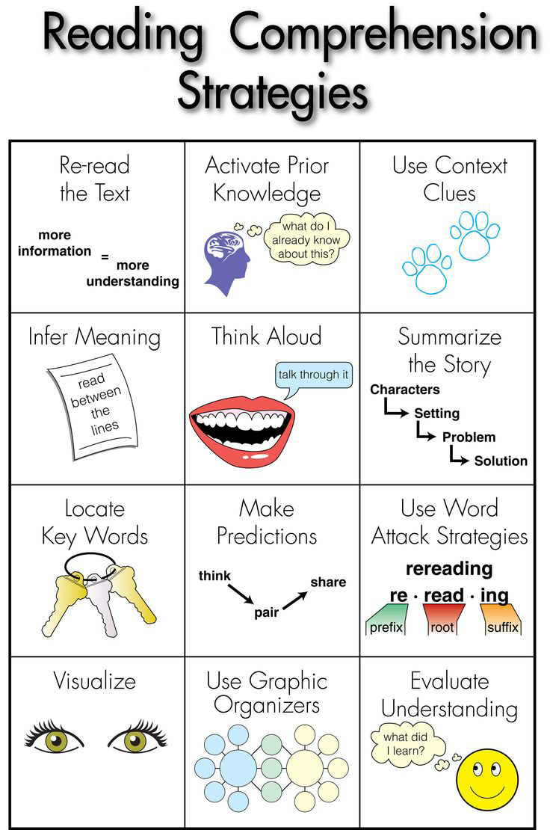

Slide 10
In order to make Reading Assessment useful in students evaluation, teacher should consider the following:
Be familiar with developmental learning process
Be flexible and willing to try out multiple assessment procedures
Teachers can test students, analyze student work samples, and observe their performing in reading tasks.
Some students may enter the classroom with special needs that require review of basic skills in reading.
Choose the best method for measuring reading progress.

Slide 11
The purpose and benefits of assessment
One purpose is to identify skills that need review. Assessment provides teachers with information on what skills students have and have not mastered. It is needed to help teachers know the skill levels of their students, since students have varying experiences and knowledge.
A second purpose is to monitor student progress. A teacher can learn which students need review before covering additional content and which students are ready to move forward.
A third purpose is to guide teacher instruction. Through consistent assessment, a teacher can make informed decisions about what instruction is appropriate for each student.
A fourth purpose is to demonstrate the effectiveness of instruction. The information gained from assessment allows teachers to know if all students are mastering the content covered
A fifth purpose of assessment is to provide teachers with information on how instruction can be improved.

Slide 12
Kinds of Reading Assessment
Reading Objective Assessment

Slide 13
Objective
Tests

Slide 14
Objective
Tests

Slide 15
Subjective Reading Test

Slide 16
Subjective Reading Test

Slide 17
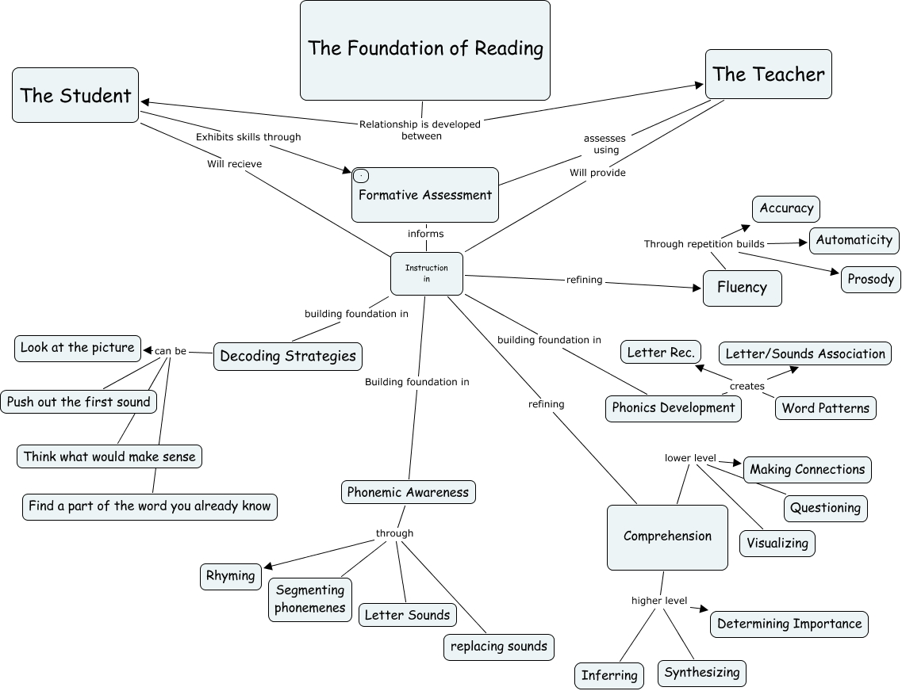

Slide 18
We can also check Reading Comprehension by using this effective strategies in class
Mind Maps (Main idea and details)
Venn Diagram
Cause and Effect Charts
Differences and Similarities
Concepts Maps
Retell a story
On line web sites for Assessing
Time Lines-Sequence of events
Summary

Slide 19
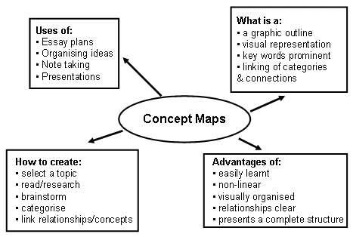
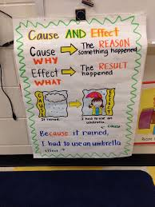
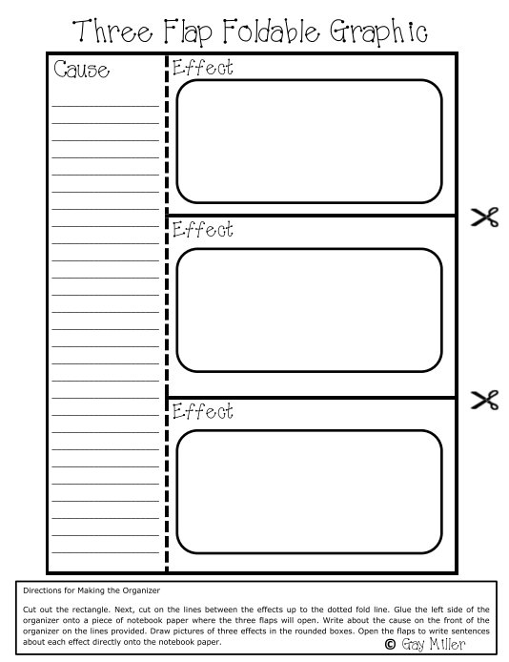
Let’s see some Examples

Slide 20
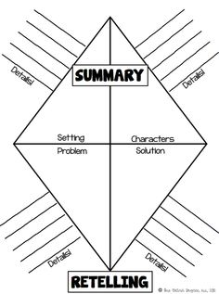
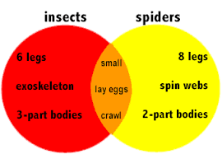
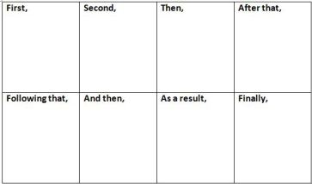
Venn Diagrams
Summary- Sequence of events

Slide 21
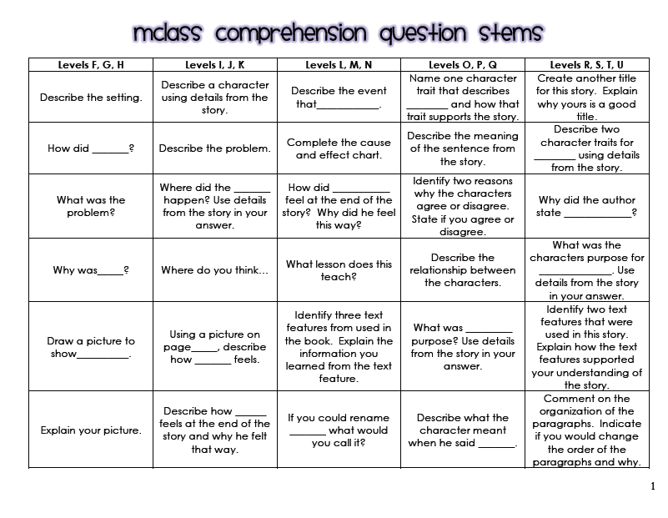
Examples of a Reading Rubric
Subjective Assessment

Slide 23
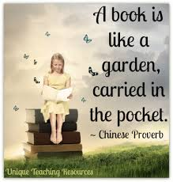
Thank You!

