Slide 1
Cinthya Canton Mencos
Evaluation Techniques
5076-14-8860
July,2015.

Slide 2
Aptitude test - Assessment
Its objective is to measure the student or employee’s innate abilities or his-her potential for achievement, it is not designed to measure knowledge.
It will show how is his-her potential to handle the job.
Example:
Popular Aptitude Tests
Numerical, reasoning verbal, reasoning logical, reasoning deducting and abstract.
Assessment is the systematic basis for making inferences about the learning and development of students. It is the process of defining, selecting, designing, collecting, analyzing, interpreting, and using information to increase students’ learning and development.

Slide 3
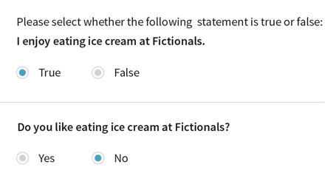
Choice Questions Criterion
A multiple choice item consists of a problem, known as the stem, and a list of suggested solutions, known as alternatives. The alternatives consist of one correct or best alternative, which is the answer, and incorrect or inferior alternatives, known as distractors.
Example:
A standard by which something can be judged or decided. The plural ‘criteria’ is more commonly encountered.
Example:

Slide 4
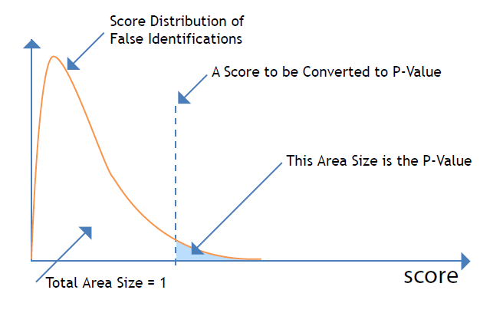
Cut score - Diagnostic Assessment
Cut scores are selected points on the score scale of a test. The points are used to determine whether a particular test score is sufficient for some purpose. For example, student performance on a test may be classified into one of several categories such as basic, proficient, or advanced on the basis of cut scores.
It can provide educators with information about each student’s prior knowledge before beginning instruction. You can use a diagnostic assessment to assist them in developing lesson plans and providing differentiated instruction to meet children’s needs.

Slide 5
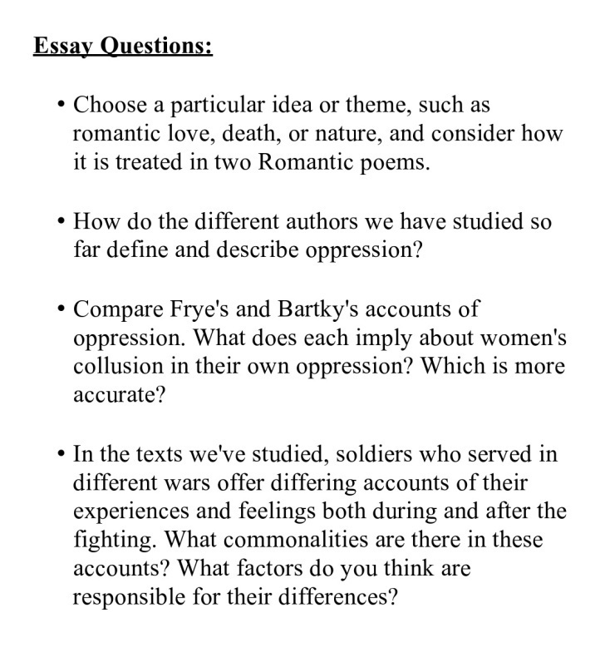
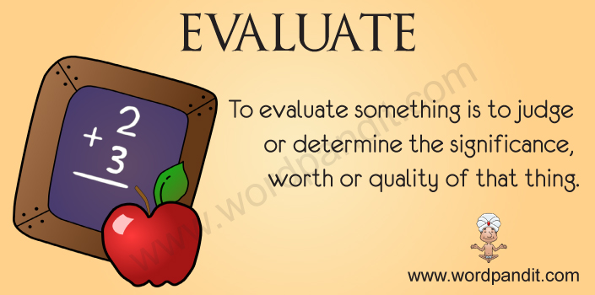
Essay Question - Evaluation
It is an examination question that requires an answer in a sentence, paragraph, or short composition.
Example:
It is to judge the condition or level of achievement of someone in a careful and thoughtful way.

Slide 6
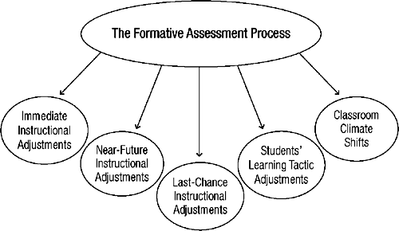
Formative Assessment - Holistic Method

Slide 7
Median Performance based assessment
It is the middlemost number in the set. The median is also the number that is halfway into the set. To find the median, the data should first be arranged in order from least to greatest.
Example 2:
During the first marking period, Nicole's math quiz scores were 90, 92, 93, 88, 95, 88, 97, 87, and 98.
What was the median quiz score?
Solution: Ordering the data from least to greatest, we get: 87, 88, 88, 90, 92, 93, 95, 96, 98
Answer: The median quiz score was 92. (Four quiz scores were higher than 92 and four were lower.)
It is to gather a demonstration of the scope of knowledge a student has on a subject rather than simply testing the accuracy of their response on a selection of questions.
Example:
Oral discussions of the subject matter may be a testing method utilized.
Portfolio Presentation
The idea is to challenge not only the student's depth of knowledge on a subject, but how they correlate multiple concepts taught within the curriculum.

Slide 8
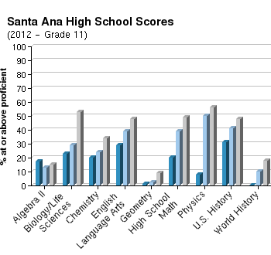
Practicality - Profile
A historical register of the performance of an individual on a group of assessments.

Slide 9
Psychometrics - Rating scale
The psychometric test is a level playing field: employers value them because they are a fair way of comparing different candidates’ strengths regardless of educational background.
A Rating Scale indicates a performance level of a specific activity.

Slide 10
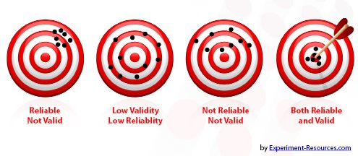
Referenced tests- Reliable test
These tests are designed to compare and rank test takers in relation to one another.
Norm-referenced tests report whether test takers performed better or worse than a hypothetical average student.
A reliable test is defined by the ability to give repeatable results.

Slide 11
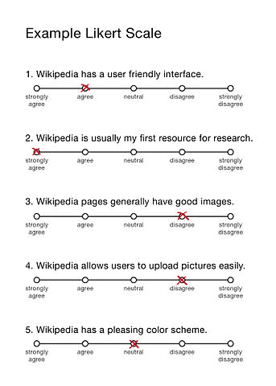
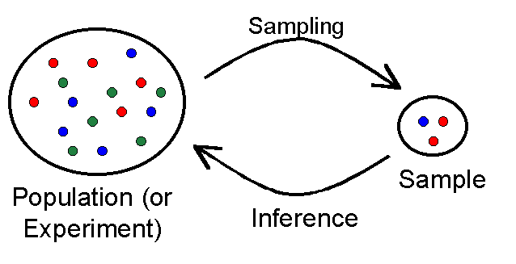
Sampling Scale
It is a process of selecting
samples for testing or analyzing.
A system of ordered marks at fixed intervals used as a reference standard in measurement.

Slide 12
Self assessment
Standardized test
It is the process of looking at oneself in order to assess aspects of an activity of a performance.
It requires all test takers to answer the same questions from common bank of questions.

Slide 13
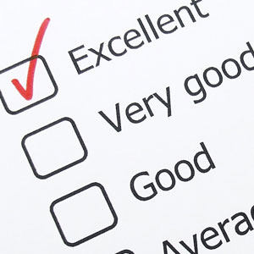
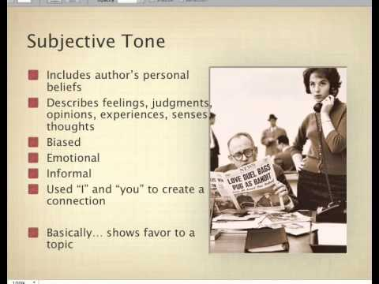
Standards
Subjective Questions
Agreed ways or values of doing something.
It is based on personal opinion, point of view or judgment or interpretation.

Slide 14
Summative assessment
The impact
They are used to evaluate student learning, skill acquisition, and academic achievement at the conclusion of a defined instructional period—typically at the end of a project, unit, course, semester, program, or school year.
Possible consequences of using a test, it can be negative or positive.

Slide 15
Valid test
The Standards for Educational and Psychological Testing
It tells us how much a test measures what it is supposed to be measuring. There are two main methods to demonstrate a test's validity. One is criterion validity and the other is content validity.
These standards are requirements for validity and reliability in educational testing.

Slide 16
WEB RESOURCES
http://www.slideshare.net/totalpeople/assessor-training-2013
http://www.mathgoodies.com/lessons/vol8/median.html
http://www.teach-nology.com/currenttrends/alternative_assessment/performance_based/
www.google.com.gt/search?q=Self+assessment&rlz=1C1GGGE_esGT515GT515&espv=2&biw=1440&bih=775&tbm=isch&tbo=
http://edglossary.org/summative-assessment/

